Slide 1
Employee Data Analysis using Excel
STUDENT NAME:KALAI SELVI S
REGISTER NO: 312216557 (autunm1647cc1221647012)
DEPARTMENT: B.com(genral)
COLLEGE:- R.B.GOTHI JAIN COLLEGE FOR WOMEN

Slide 2
PROJECT TITLE
Employee Performance Analysis using Excel

Slide 3


AGENDA
Problem Statement
Project Overview
End Users
Our Solution and Proposition
Dataset Description
Modelling Approach
Results and Discussion
Conclusion
3/21/2024 Annual Review

Slide 4

PROBLEM STATEMENT
Efficiently managing and analyzing employee data is challenging. This project aims to use Excel to organize, analyze, and generate insights from employee data to support better decision-making.

Slide 5

PROJECT OVERVIEW
.
The "Employee Data Analysis Using Excel" project organizes employee data into a structured Excel format. It uses Excel’s tools to analyze key metrics and generate reports. The goal is to provide insights for better decision-making and improved workforce management.

Slide 6
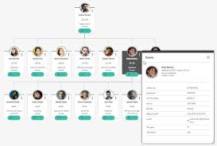

WHO ARE THE END USERS?
HR managers
Team leaders
Business analysts

Slide 7

OUR SOLUTION AND ITS VALUE PROPOSITION
Conditional Formatting- To Find Missing Elements
Filter :- To Remove The Blank Space
Formula :- Performance
Pivot :- Summary of The Analysis
Graph :- Data Visualization

Slide 8
Dataset Description
Employee data was downloaded from Kaggle
There are 26 features in the Employee data
We used 9 Features from it they are
Emp id - num
Name - text
Employee type
Perfomance level
Gender male or female
Employee Rating – Numerical Values
Bussiness Unit

Slide 9

THE "WOW" IN OUR SOLUTION
Calculation of Performance level:-
=IFS(Z9>=5,"very high",Z9>=4,"high",Z9>=3,"med",TRUE,"Low")
3/21/2024 Annual Review
9

Slide 10
MODELLING
Data Collected:-
From Kaggle
Features Collection:-
1)Employee id:- Numerical Value
2)Employees:-
First name
Last name
3)Employee type
4)Bussiness unit
5) Perfomance Level
6)Gender- male or female
7)Employee Rating
10

Slide 11
Data Cleaning:-
1)dentified Missing Value
2) Filtered Missing Values
Performance Level:-
calculated for Column’ Z’
Summary:
Pivot Table:
Features used-
Drag Business Unit to Row
Drag Performance level to Column
Drag First Name to Values
Drag Gender Code to filters
Remove Blanks

Slide 12
Visualization:-
Preparing Graph-
Go to insert-graph
Add Chart title
Add Trendline- to the Medium and the lowest

Slide 13
RESULTS
13

Slide 14
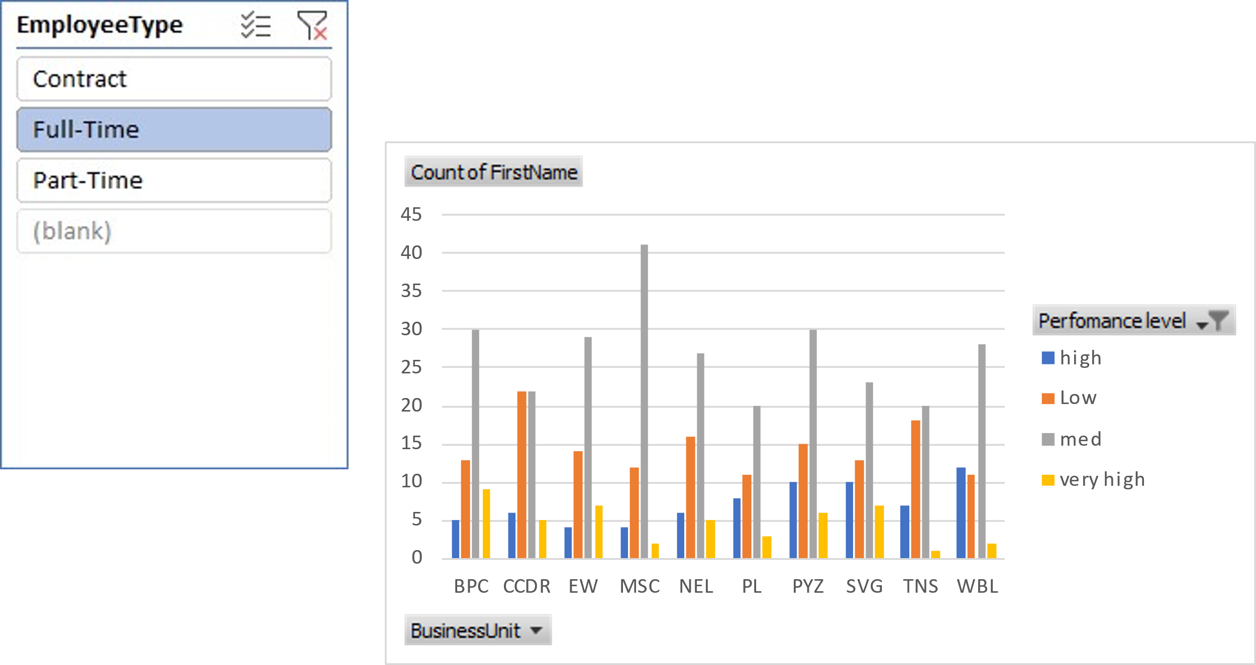
The table and the graph for the employee of Full time :-
Count of FirstName | Column Labels
Row Labels | high | Low | med | very high | Grand Total
BPC | 5 | 13 | 30 | 9 | 57
CCDR | 6 | 22 | 22 | 5 | 55
EW | 4 | 14 | 29 | 7 | 54
MSC | 4 | 12 | 41 | 2 | 59
NEL | 6 | 16 | 27 | 5 | 54
PL | 8 | 11 | 20 | 3 | 42
PYZ | 10 | 15 | 30 | 6 | 61
SVG | 10 | 13 | 23 | 7 | 53
TNS | 7 | 18 | 20 | 1 | 46
WBL | 12 | 11 | 28 | 2 | 53
Grand Total | 72 | 145 | 270 | 47 | 534

Slide 15
conclusion
Through Excel-based analysis of employee performance data, key trends and metrics were identified, enabling better decision-making. This analysis provides actionable insights to improve productivity, helping HR, managers, and employees optimize performance and contribute more effectively to organizational goals.

